Slide 1


A Holistic Analysis
Of New Admissions & Requests.
By Toluwase Idowu

Slide 2
Background of Analysis
One of the key benchmarks for evaluating the efficacy of local health and social care services is their collective capability to minimize avoidable admissions to care homes. This is often interpreted as an indication of prolonging independence and delaying dependency for individuals. A prevailing sentiment suggests that individuals greatly value their autonomy, desiring to remain in their homes for as long as feasibly possible. However, interpreting care home admissions requires a nuanced perspective. While high admission rates can sometimes spotlight the absence of quality, affordable care options, it's also imperative to recognize that for some individuals, moving to a care home can signify a positive shift, enhancing their overall well-being and living conditions.

Slide 3
According to Nuffield Trust “The overall number of council-supported admissions of adults to care homes (residential and nursing homes) has decreased over time. This could be interpreted as being due to a shift in preference towards home-based social care. But since there is no reliable data on home care, it could also represent a fall in social care provision. As there is an ageing population, it could indicate an increasing level of unmet need.” (Admissions to care homes | Nuffield Trust)

Slide 4
What is the Reason for this Analysis?
This analysis is conducted to monitor and improve the Coventry City Council health support services across to the city. The dataset provided for this analysis was checked against the 5 Vs of Big data (Volume, value, Variety, Velocity and Veracity), this is to ensure the dataset meets the quality and standards needed for this analysis. Also, the UK’s GDPR compliance was taken into consideration all through the process of conducting this analysis.

Slide 5
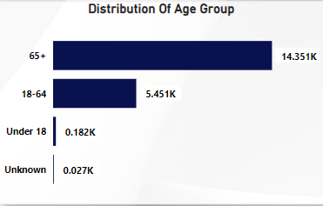
Summary
The program currently serves a diverse client base of 20,011 individuals. Delving into age demographics, a significant majority of 14,351 clients are above the age of 65. The age bracket of 18-64 years follows with 5,451 clients, while the youngest group, those under 18, comprises 182 individuals while, 27 people’s age group was unknown. (Refer to the Chart: Distribution of Age Groups).
During the reporting period, the program received a total of 32,592 requests. New enrolments accounted for 1,425 of these, while 11,126 clients have been engaged in our long-term support services.

Slide 6
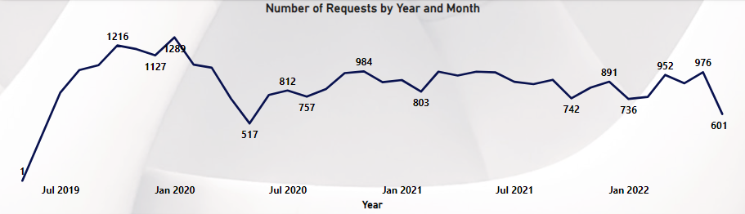
Request Overview
The analysis reveals that the predominant routes generating requests were 'Community/Other' and 'Discharge from Hospital', tallying 22,651 and 9,479 requests respectively. Of these, 8,778 resulted in Short Term Support. Meanwhile, 8,735 requests culminated in no services being rendered, and 8,452 led to Low Level Support. The remaining requests were distributed among various other outcomes. Additionally, throughout the observed period, the number of requests exhibited a fluctuating trend, reaching its zenith in January 2020 with approximately 1,289 requests.

Slide 7
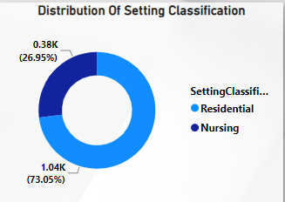
New Admissions Overview
The analysis reveals that among the new admissions to the program, the predominant setting is residential, comprising 1,041 individuals. In contrast, 384 have been placed in nursing homes. Diving deeper into the reasons for admission, 584 clients needed support for physical personal care, 468 were facing memory and cognition challenges, and a distinct 2 sought assistance due to social isolation or other related issues. The influx of admissions peaked in July 2021 with 56 entrants, while June 2022 saw the fewest, recording only 5 new intakes.

Slide 8
Long-term Support Overview
In the summary of long-term support, the "Community-Personal Budget" had the most clients at 5,110. On the other hand, the "Community - Part Direct Payment Support Type" had the fewest with 243 clients. When looking at the main reasons for long-term support, "Physical Personal Care Support" led with 5,190 personnel. This was followed by "Learning Disability Support" with 2,208 personnel, and lastly, "Social: Support to Carer" had just one person.

Slide 9
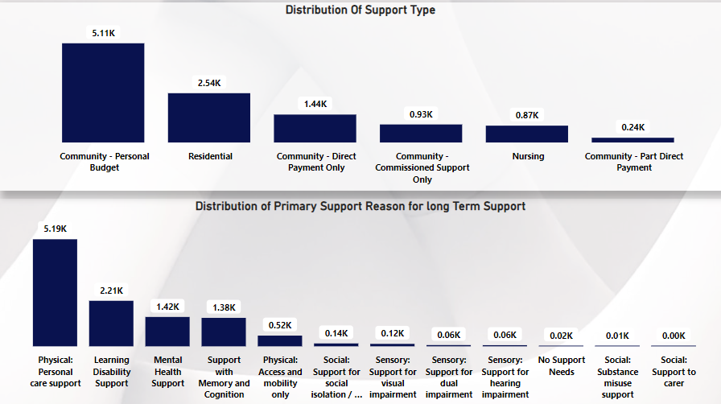

Slide 10
Recommendations & Conclusion
1. Data Collection & Reporting:
Enhance Data Recording: A significant portion of requests comes via "Unknown" routes. Consider refining the data collection processes or tools to minimize these ambiguities.
Re-evaluate Data Sources: The high number of "Unknown" and “NULL” entries may suggest issues with data sources. It might be beneficial to review and possibly consolidate where the data is coming from.
2. Service Provision & Enhancement:
Awareness Campaigns: Given that most of the request’s result in "Advice and Information" being provided, there may be a gap in public knowledge about available services. Consider launching awareness campaigns or informational sessions.
Expand Community Based Care: With most new admissions being in community settings, there's evidence of a preference or system emphasis on community-based care. Consider expanding resources, training, and facilities in this area.
Address Specific Needs: The primary reasons for long-term support and new admissions indicate specific areas of need, such as learning disability support and physical personal care support. Enhancing specialized services in these areas could be beneficial.

Slide 11
Recommendations & Conclusion
3. Client Support & Engagement:
Enhance Support for Elderly: The age distribution suggests a significant proportion of clients are over 65. Tailoring services, resources, and outreach programs to cater to the specific needs of this demographic can be advantageous.
Revisit Admission Criteria: The peak in admissions in July 2021 suggests a potential seasonal or event related spike. Investigating the causes can help in planning and resource allocation in the future.
4. Strategic Planning & Forecasting:
Analyze Trends: The fluctuating pattern of requests and admissions suggests varying demands over time. Analysing these trends can help in forecasting and strategic planning.
In conclusion, while the data provides a comprehensive overview of the current state, it's crucial to continually re-evaluate and adapt based on evolving client needs, feedback, and external factors. Regular reviews, combined with strategic planning based on the data, can help in providing optimal support to clients.

